Slide 1
Dashboard Summary
This presentation summarizes key patterns and insights using descriptive text.

Slide 2
Sales Trend Summary
• Sales show a steady increase from January to June.
• April and May demonstrate the strongest growth.
• The pattern suggests rising demand in later months.

Slide 3
Key Insights
• Consistent upward trend indicates strong market performance.
• Monitoring mid-year spikes can help optimize inventory.
• Sustained growth points toward effective customer engagement.

Slide 4
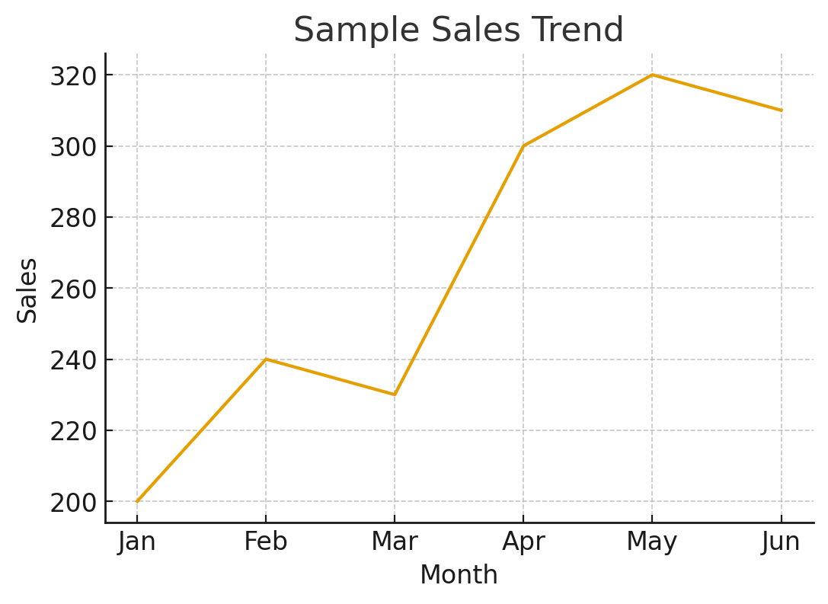
Sales by month

